Slide 1
EAP Software Support
Ticketing Portal
Brad Forgey
Roeing Corporation
August 9, 2018

Slide 2
Support Options
Roeing will provide tier 1 support for the software
Ticketing Portal access for all agencies
Contacting Support
  Email an issue to DMSSupport@roeing.com
  Login to the portal and enter a ticket
  Call 888-787-5402 and mention Energy Assistance

Slide 3
Ticket Portal Features
View Current Tickets
  Ticket Status
  Resolutions and Questions
  Update Ticket Information
Enter New Tickets
Automatic Email Notification of Ticket Updates

Slide 4
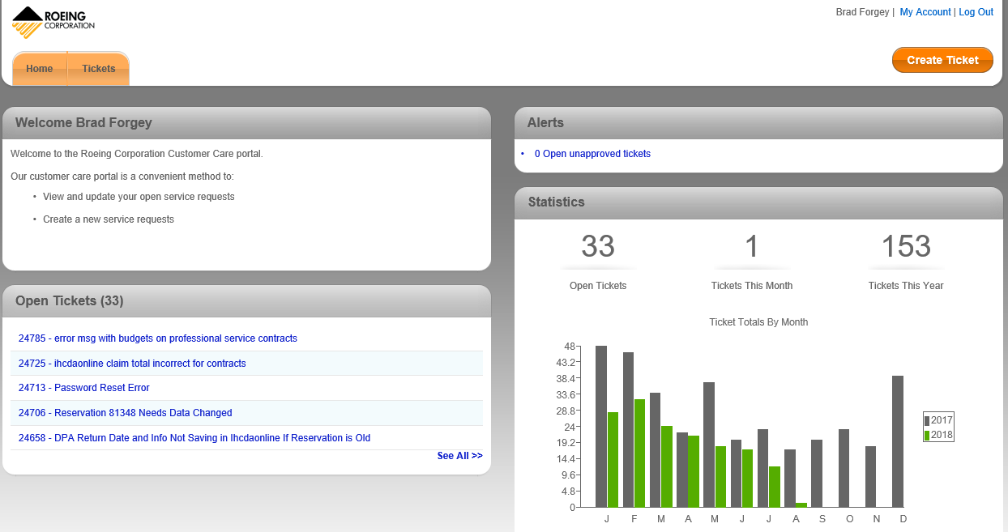

Slide 5
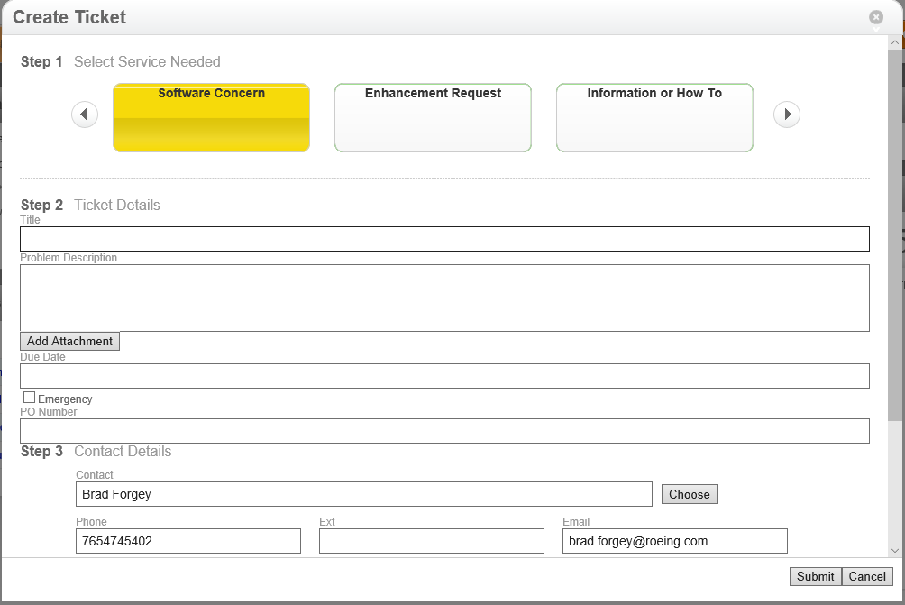
Create a Ticket

Slide 6
Ticket Information
Title – General Description of the Problem
Problem Description – Description of the issue and how to reproduce the issue. Please do not add PII data like SSN.
Add Attachment – You can upload screen shots or a document.
Emergency – Please only mark if it really is an emergency.
Submit – This will create the ticket and notify our help desk staff.

Slide 7
Ticket Process
Ticket is created. You will receive an email confirmation.
Roeing Helpdesk staff is alerted.
If we need more information, the ticket status will be changed to ‘Waiting on Customer’ and you will get an email with the information we need.
You can either respond to the email with more details or login to the ticket portal.
Tickets will be resolved with either:
  Resolved in Production – issue is resolved now
  Resolved for Release – issue requires an update that is being tested for release

Slide 8
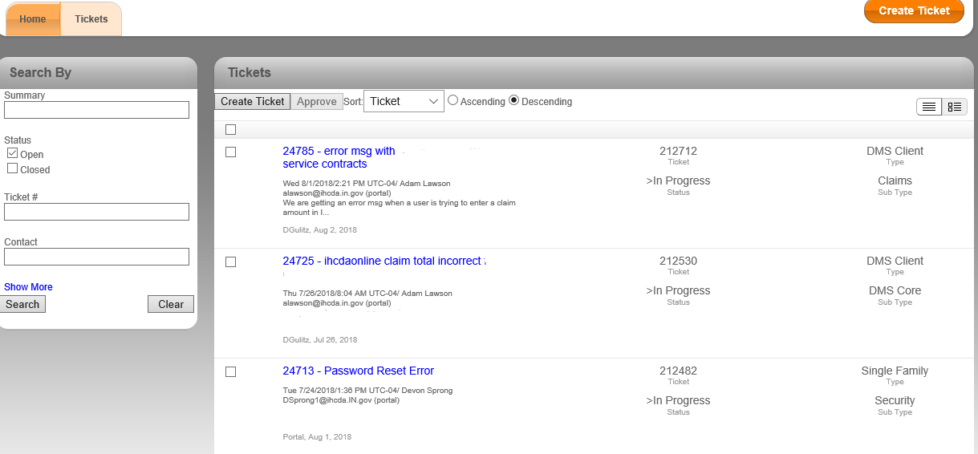
Tickets Tab

Slide 9
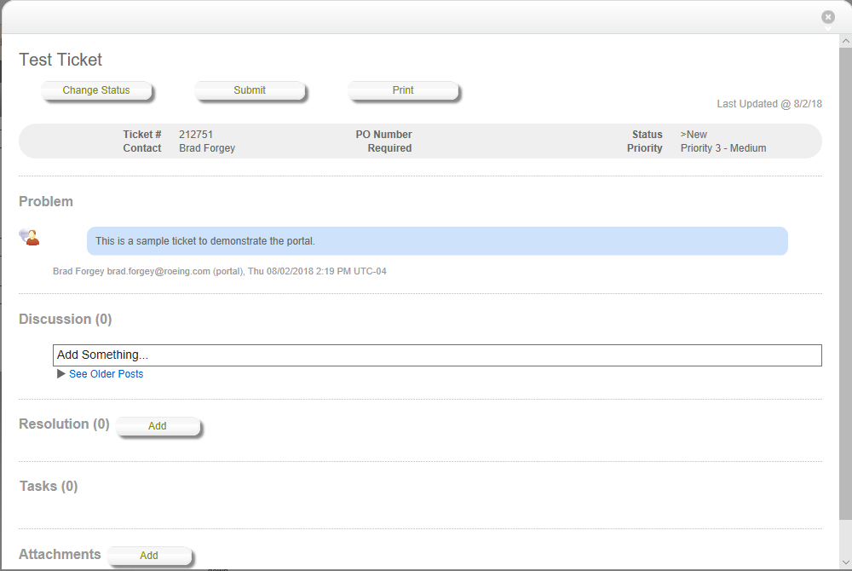
Ticket Information

Slide 10
Ticket Status
New – Ticket has not been looked at by helpdesk yet.
In Progress – Ticket is being looked at.
Waiting on Customer – We need more information from you.
Closed – The ticket was cancelled (in the case of a duplicate)
Resolved In Production – The issue is resolved in the system now.
Resolved for Release – We will need to release a code update to resolve the issue. That is in progress.

Slide 11
Tickets by Email
Our preferred method.
Email your issue to DMSSupport@roeing.com
You can attach screen shots if available.
Ticket will be automatically created.
You will get notifications automatically.

Slide 12
Phone Support
Help desk hours are 8 to 5 Eastern
888-787-5402 and mention Energy Assistance
We will create a ticket if you call in so the issue can be tracked.

Slide 13
Links
https://apps.roeing.com/riaa
  This slide deck
  Ticketing Documentation
  RIAA installers
  Other Information

